Slide 2
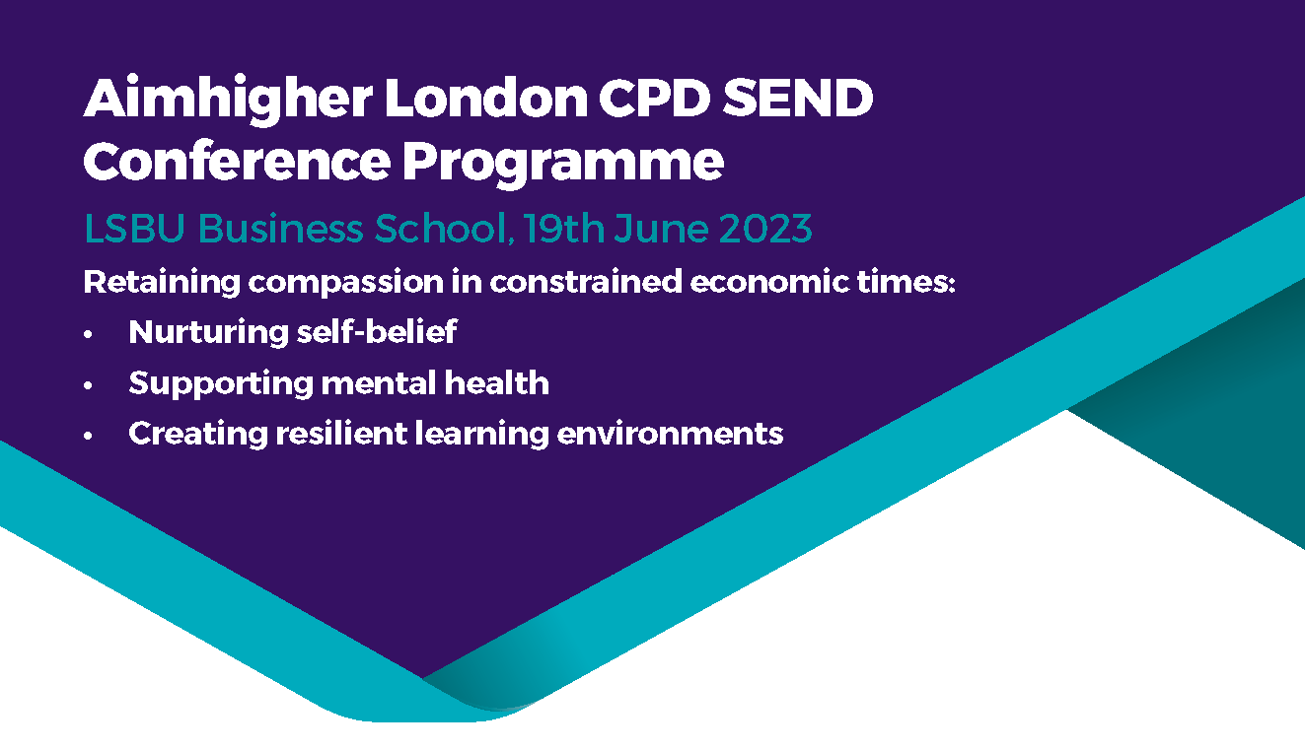



Slide 3
Support young people with SEND to succeed
Dame Christine Lenehan

Slide 4
Todays presentation
Gives you a brief overview of the SENDAP Improvement Plan
Has two programmes where we are working with young people
Highlights some of the tools we use

Slide 5
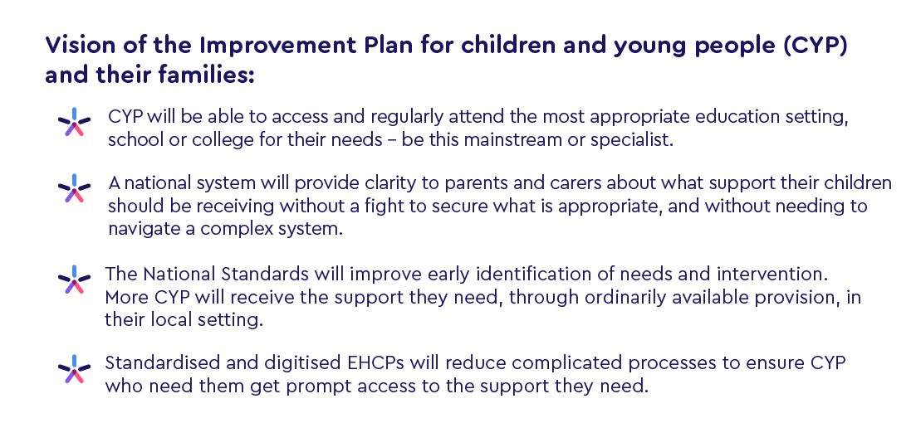
Headlines from the plan

Slide 6
A national system underpinned by National Standards
The DfE will work with stakeholders to deliver a standard EHCP template, with supporting processes and guidance from 2025.
The process should be easier to navigate, with parents being clear on what support they can expect for their child and where they can turn for help, including how to make use of support through the SEND Local Offer and SEND Information, Advice and Support Services (SENDIASS).
The national system will provide clarity on the resources available to deliver the right provision, for example, by ensuring that the new SEND and Alternative Provision National Standards are clear on which budgets should be used to provide different types of support.
National Standards will place a greater emphasis on the important role mainstream settings play in providing quality first teaching and evidence-based SEN Support to meet the needs of the majority of pupils with SEND, so that all settings provide the same high-quality provision.
The delivery of National Standards will be supported by new SEND and Alternative Provision practice guides for frontline professionals and an amended SEND Code of Practice.

Slide 7
Successful transitions and preparing for adulthood
Publish guidance to support effective transitions between all stages of education, and into employment and adult services.
Continue to support the Department for Work and Pensions’ Adjustment Passport pilot to smooth the transition into employment.
Improve the Disabled Students’ Allowance process, by continuing to work with the Student Loans Company to reduce the time for support to be agreed.
Develop further work in Careers Guidance for young people with SEND

Slide 8
Strengthened accountabilities and clear routes of redress
Publish local and national inclusion dashboards.
Deliver updated Ofsted and Care Quality Commission area SEND inspections.
Give the Secretary of State for Health greater powers through the Health and Care Act 2022.
Require every integrated care board to have a named executive board member lead accountable for SEND.
Set up an expert group to support the development of a bespoke national alternative provision performance framework.
Improve advice and guidance for families on mediation and update the professional standards for SEND mediators.

Slide 9
Education Health and Care Plans
Eligibility for EHC plan is based on educational need
Plans based on integrating services to meet holistic outcomes
Health services can request that a local authority carries out an EHC assessment
Assessment by Local Authority - must seek advice of relevant health professionals.
Advice by health professionals must be provided within 6 weeks
There must be agreement between ICBs and LAs on the health provision in EHC plans
Any health provision in EHC plans must be commissioned by health
Notes:
AF
Education Health and Care Plans are a new feature of the reformed system and replace Statements of SEN. These are statutory documents, the eligibility for which is based on educational need.
Related to my earlier point on the identification, by health, of a SEN or disability – it is important to note that health services can request that a local authorities carry out EHC assessments. Again highlighting the importance of early identification and planning in order to achieve the best outcomes for children and young people at all life stages right into transition to adulthood and beyond.

Slide 10
What do we believe
Across the country, young disabled people are leading the way in their chosen field of expertise. We know that they are ambitious and work immensely hard to achieve their goals, as well as having a positive impact on their community. We don’t hear about their successes often enough. Their achievements should be celebrated and their skills acknowledged. Having spent most of my own working life focused on improving outcomes for disabled children and young people, I am consistently inspired by young people’s determination to create change, often in the face of great adversity
Notes:
All of us here had support to prepare for our adult lives, through families, communities and different services, either universal like GPs, Schools etc, or more targeted services.
We can support children and young people from birth, giving them opportunities to practice decision making. To understand the consequences of their decisions, and how to learn from any mistakes they might make. Failing and making poor choices is something we all have done, and we often learn most from the decisions which didn’t go well.
Young people have rights in relation to making their own decisions about their EHC plan from the end of the academic year in which they turn 16. They have the right to request an assessment, to make representations about what goes into their plan, and to choose which institution they wish to attend. These are importance decisions, and as parents you can support young people to understand them well in advance of this point. What kind of subjects would they like to study? What sort of institution would they like to go to? You can help them to attend open days at different schools or colleges so that they can get a real sense of what a placement would be like.

Slide 11
Destinations
Their stories will inspire the professionals working in our schools, colleges, and care settings, but should also show how important employers can be in all of our lives. We should have the highest aspirations for our young people. Dan Watkins, one of the young people featured , says, “everyone should feel wanted, valued and part of something special. There’s a place for everyone in the community.” We still have a long way to go in creating a world that is accessible and inclusive for young disabled people, and we will maintain our commitment to that objective.
Notes:
All of us here had support to prepare for our adult lives, through families, communities and different services, either universal like GPs, Schools etc, or more targeted services.
We can support children and young people from birth, giving them opportunities to practice decision making. To understand the consequences of their decisions, and how to learn from any mistakes they might make. Failing and making poor choices is something we all have done, and we often learn most from the decisions which didn’t go well.
Young people have rights in relation to making their own decisions about their EHC plan from the end of the academic year in which they turn 16. They have the right to request an assessment, to make representations about what goes into their plan, and to choose which institution they wish to attend. These are importance decisions, and as parents you can support young people to understand them well in advance of this point. What kind of subjects would they like to study? What sort of institution would they like to go to? You can help them to attend open days at different schools or colleges so that they can get a real sense of what a placement would be like.

Slide 12
Employment Opportunities
The vast majority of young people with SEND are capable of accessing paid employment opportunities, with the right support.
We need to be creative when we are thinking through what good opportunities can look like. There are a wide range of potential options for young people with an EHC plan including: supported internships, traineeships, study programmes, job coaching, Access to Work funds.
Notes:
You will see from the other specific talks on employment today that there are a huge wealth of opportunities out there for children and young people to gain employment skills and experience.
I had an interesting conversation which I wanted to reflect on here. We recently had a parent contact us asking for support for a young person. He is very interested in being a first aid practitioner. He also has autism, dyspraxia and dyslexia. In various conversations about his future once he reaches 18, she reflected that she had been told he could access supported employment opportunities in hairdressing and hospitality, but that there was no available support for him to follow his dream.
We should not just be supporting young people to access some very specific forms of employment, but instead to be creative, to focus on their strengths and aspirations.
www.base-uk.org – British Association for Supported Employment has a wide range of information and links to support on their website

Slide 13

Tomorrow’s Leaders https://councilfordisabledchildren.org.uk/help-resources/resources/tomorrows-leaders-world-beyond-disability
The Education and Training Foundation (ETF) and Council for Disabled Children have published: Tomorrow’s Leaders – A World Beyond Disability.
This exciting new publication profiles the achievements of over 30 inspirational disabled young people who are leading in their communities, with ambition, hard work and dedication to improving society.
Notes:
Across the country, young disabled people are leading the way in their chosen field of expertise. We know that they are ambitious and work immensely hard to achieve their goals, as well as having a positive impact on their community. We don’t hear about their successes often enough. Their achievements should be celebrated and their skills acknowledged. Having spent most of my own working life focused on improving outcomes for disabled children and young people, I am consistently inspired by young people’s determination to create change, often in the face of great adversity. I am delighted that the Council for Disabled Children and our Transition Information Network have been able to support the Education and Training Foundation (ETF) in developing this publication showcasing young disabled people’s stories. They are stories that are diverse. They represent the wide range of goals, knowledge and accomplishments of our young people. Some are excelling in the arts, others in academia, others still in sports. Many are involved in designing services and influencing policy to better reflect the needs of disabled people. All are linked by a dedication to helping others. Their stories will inspire the professionals working in our schools, colleges, and care settings, but should also show how important employers can be in all of our lives. We should have the highest aspirations for our young people and I hope that these stories will be valuable asset for all disabled children and young people. As Dan Watkins, one of the young people featured here, says, “everyone should feel wanted, valued and part of something special. There’s a place for everyone in the community.”

Slide 14
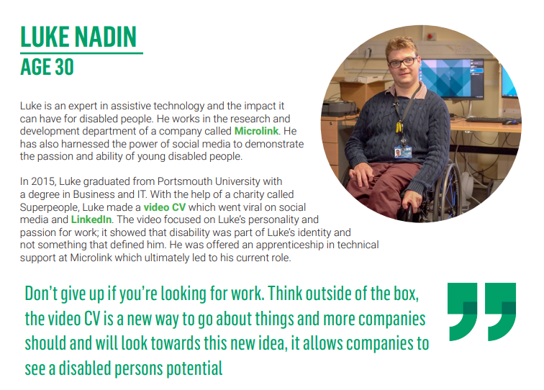

Slide 15


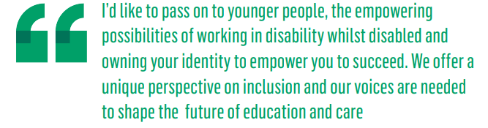
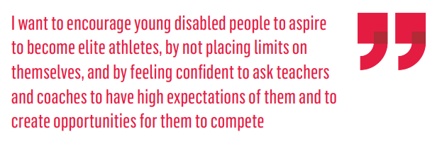
Some more quotes from the Tomorrow’s Leaders…

Slide 16
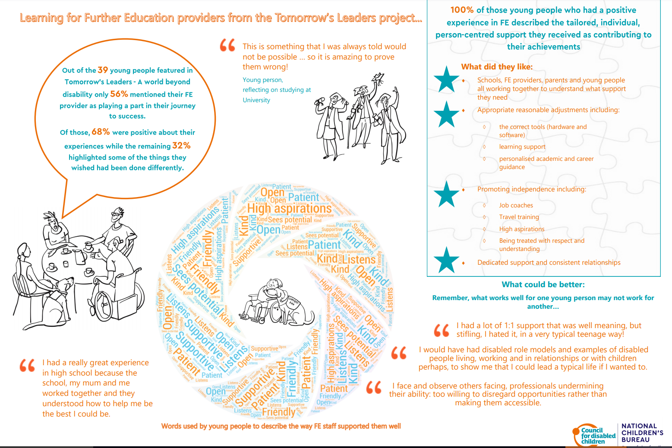

Slide 17
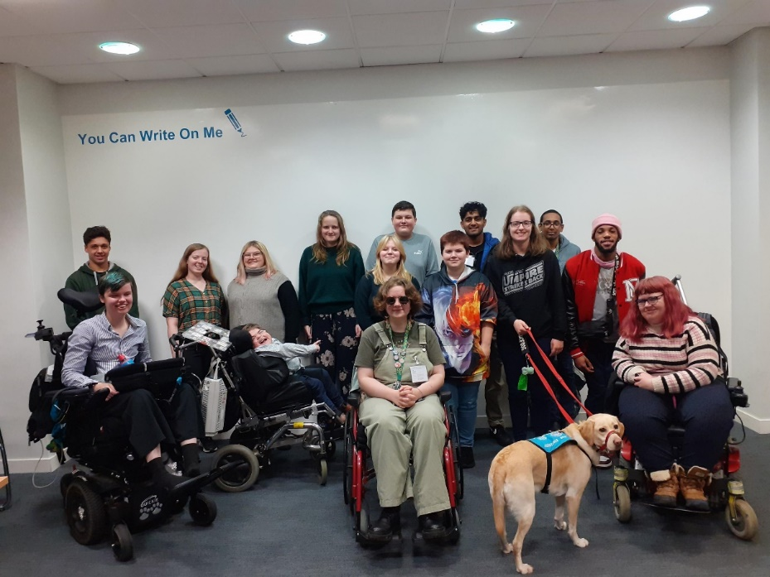
Notes:
One of the key elements of Making Participation Work is engaging children and young people in both their local areas and nationally. One way we do this is through FLARE’s advisory work to the DfE.
Examples of FLARE’s work:
Advisory work for the DfE and other organisations. Recent topics FLARE have discussed in their advisory work to DfE:
How LAs should be working with CYP when delivering the SEND and AP Improvement Plan
Law Commission Review of Children’s Social Care Legislation
DfE’s sustainability and climate change strategy
Multi-Agency Panels
Co-designing the YVM conference
Delivering learning events for professionals and practitioners
Youth-led blogs and podcasts give young people a public voice
Creating resources designed to support young people to share their voice. E.g., supporting young people in EHCP review meetings, health and policy term jargon busters, participation strategy exemplar, top tips for EHCP participation
Example: FLARE co-designed our consultation questions when responding to the SEND & AP Green Paper
& much more!

Slide 18
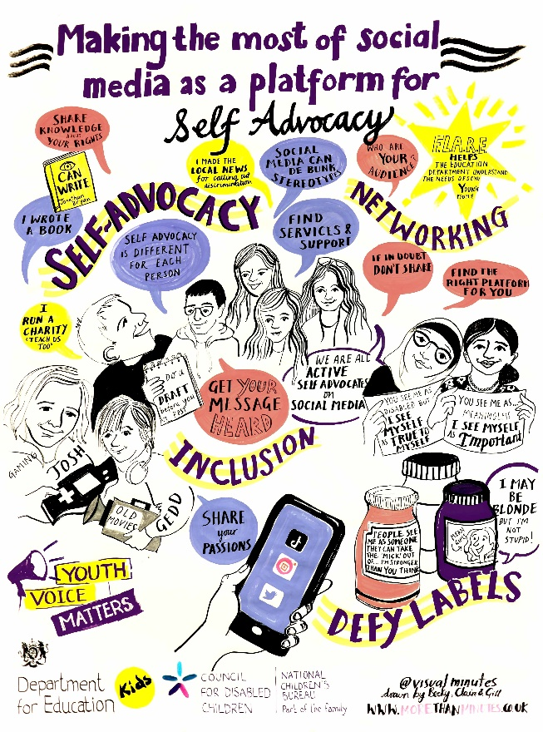
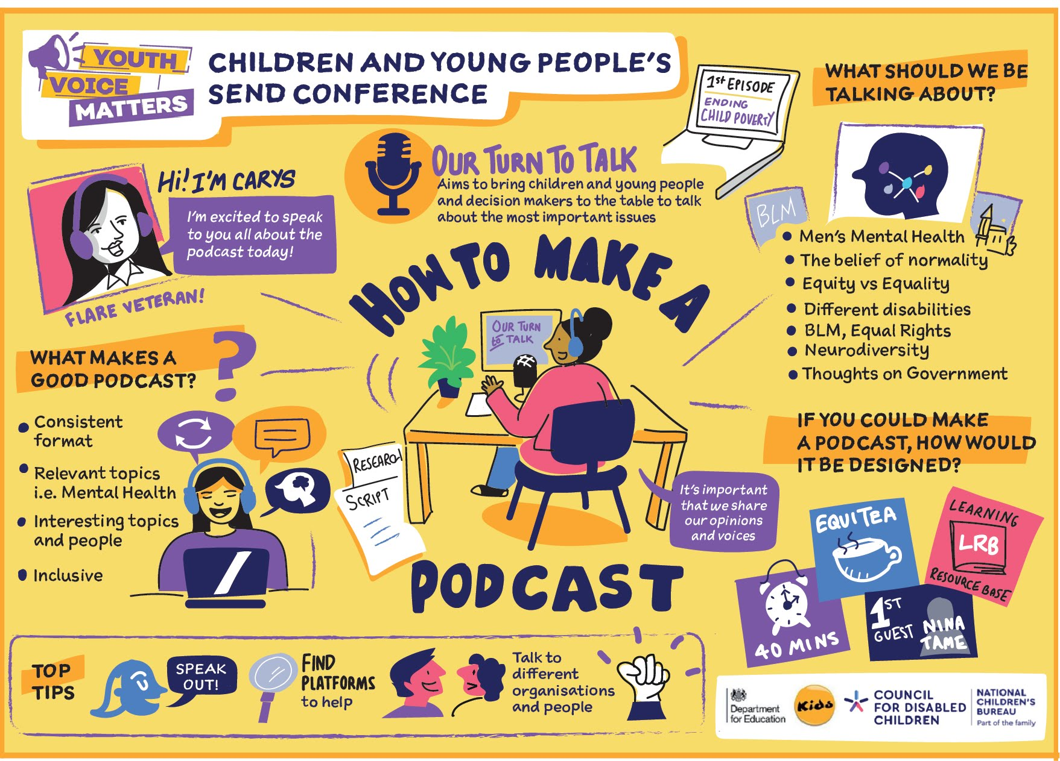
Notes:
Some examples of FLARE members delivering workshops at our events, captured by graphic facilitators

Slide 19
What do FLARE think ?
March 2017: Post-16 experiences
FLARE wish they had known…
More about special colleges
More information about post-16 options
All the different stages of post-16
That everything would be ok

Slide 20
What schools do well to prepare CYP for post-16
Lots of work experience opportunities
School provides us with a lot of information about opportunities, so we can make a more informed decision on what we would like to do
Informed me of my option choices and the consequences
Helped with college
Providing a good level of support whilst choosing post 16 subjects
Helps me by providing work experience
Good advice about attending a special college
Telling you about ‘A-Level’ choices and other qualifications

Slide 21
What schools do less well to prepare us for post-16
More deaf awareness
More information on transition to university
Not person-centred
Schools may not be so good at providing the support needed in order to take part in opportunities, e.g. transport and keeping up to things they said they were going to do
Start process of post 16 earlier
Inclusive work experience
Providing continuity, consistency and emotional support around what is going to happen next
Not enough support with work/tasks

Slide 22
What is exciting when we think about employment?
Earning money, having value in the world’s eyes, purpose, making a difference
Learning independence, like budgeting and travelling to and from work
Work in a team, develop new skills and work towards the same goals
Feeling like you’re making a difference
Meeting new people, improved mental health, being valued, being able to live and support ourselves
New friends and skills, give us a better idea of our future career
Showing people who may have lower self-esteem that you can achieve anything
Learning skills which make you more employable
I really like the idea that you can find a job that suits you
It gives us a better idea of what we might like to do when we are older

Slide 23
What support have you experienced
Careers advice, virtual work experience, spring pod courses
We had a good careers day at my school. You could try out the jobs, and they were jobs you can do straightaway (like a gym, recycling centre, charity shop). Learnt about references
At university there is some support for those on specific courses, i.e. nursing
Lessons on writing about ourselves for job applications and how to be confident in an interview
Received a call from Connections who offered to help with employment searching
Interview and application practice was helpful
Discrimination in employment, not making reasonable adjustments
Emphasis on young people having to change themselves. Legal responsibility, difficult to prove the experiences that you have had
I had a supported employment visit from my Local Authority

Slide 24
What is challenging when we think about employment
Getting turned down for jobs because of disabilities. Employers don’t see it as an asset or give us a chance to show/prove ourselves
Lots of people assume that disabled people want to only volunteer and not be paid. Some people think that disabled people don’t need money!
Ableism in employment
More varied apprenticeships
I don’t think I would be able to work in a standard job or full time due to my disabilities – from assessments I’ve had looking after my health is a full time job
Employers being disability confident and understanding
Everything! Access physically, spelling board, who would employ me? Appointments, pace, stamina, attitudes
Location – need supported internships/apprenticeships in more areas
Although discrimination is against the law, it still happens and is very hard to prove and prosecute

Slide 25
What worries you , what have you done ?
I have set up my own business so I can be more flexible and set my own pace. Also so I can avoid having to deal with employers
People’s perceptions
I don’t know if I will ever get good at answering questions in an interview. Every job seems to need reading and writing, and I find it so difficult to do that
It can be tiring to understand people when they are talking through a mask
Benefits – because they can affect the amount of money we can earn. E.g. initially I wasn’t allowed to work on the Kickstart scheme because of the amount of Universal Credit I get
I don’t know if I will get the qualifications that employers want
Accessibility and the fear of whether the employers will be autism-friendly/friendly towards accommodating disabled people

Slide 26
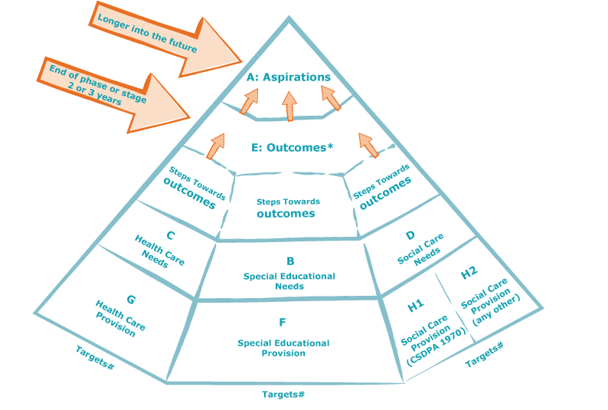
Outcomes and the EHC Plan
Notes:
AF
One useful resource for practitioners is this outcomes pyramid which CDC developed. It’s in the resource where it does some fancy interactive things, its a tool for services to identify aspirations and outcomes which then lead to the steps that need to be taken to achieve the outcomes.
Starting at the top with aspirations, which are more long term and should be identified through early conversations.
The next level is outcomes - An outcome is described as the benefit or difference made to an individual as a result of an intervention . Importantly these are not service outcomes but life outcomes of CYP, they are not provision. They should be challenging and based on high expectations clearly linked to the aspirations.
Below outcomes are the steps to be taken towards them – this is where we can talk about provision – but that's provision with a clear vision and objective towards reaching an outcome. Those bottom two tiers are a way of services identify needs and how they provide interventions to meet those needs.
The letters A to H2 apply to the sections of an EHC plan.

Slide 27
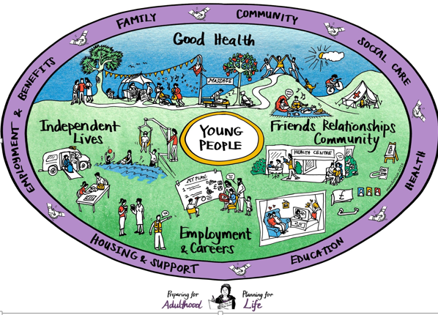
Notes:
You may have seen this graphic which was generated as part of the Preparing For Adulthood programme. These preparing for adulthood outcomes are vital elements and should help to focus our thinking on transition. There are four key outcomes, good health, independent living, friends, relationships and community and employment and careers.
It is important that we remember that a fulfilling adult life is big and complex, and made up of lots of elements. It does not just include independent living, or employment opportunities, but is much broader than that.

Slide 28
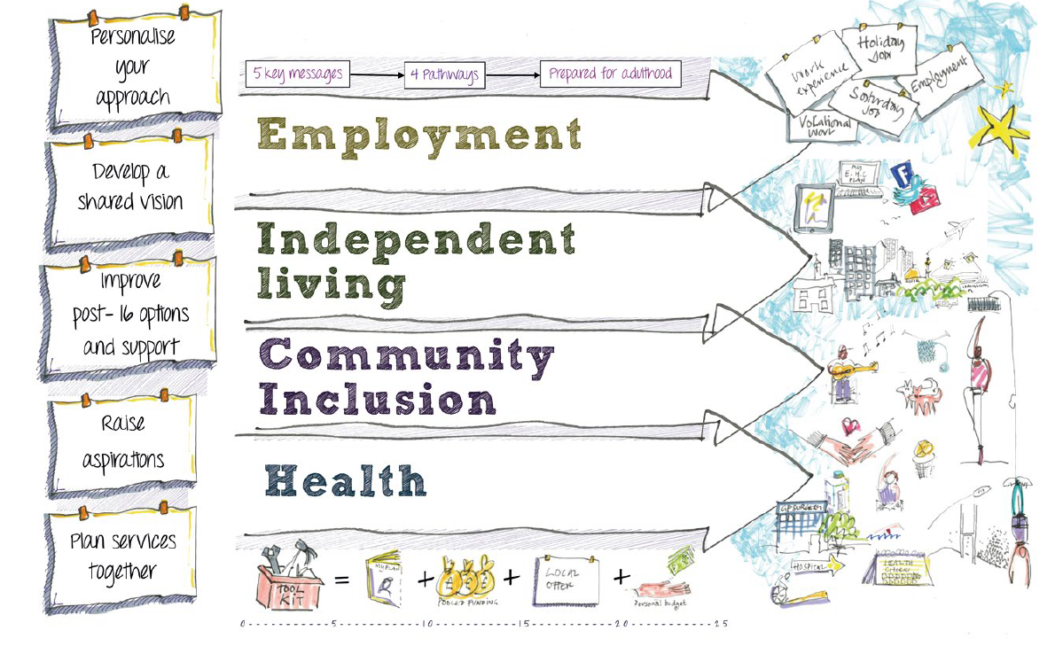

Slide 29
More resources
https://councilfordisabledchildren.org.uk/resources-0/preparing-adulthood

Slide 30
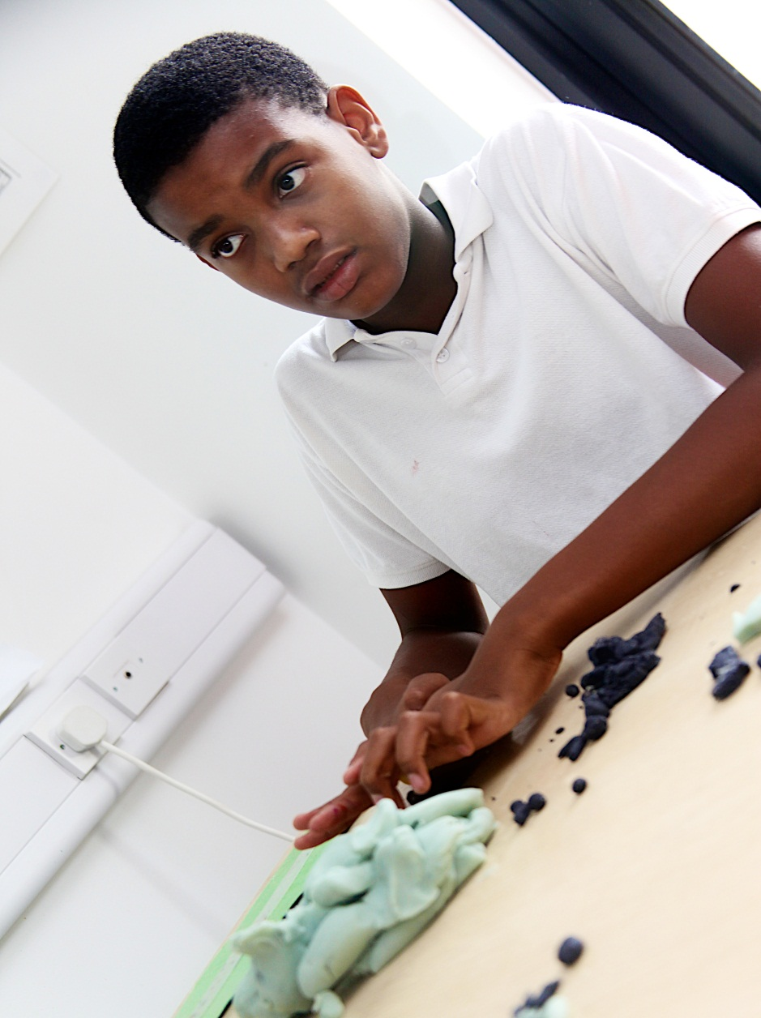
"The greatest danger is not that our aim is too high and we miss it, but that our aim is too low and we hit it"
Michelangelo
30

Slide 32
The Disabled Student Commitment:
Creating Resilient Learning Environments
Aim Higher London
Retaining Compassion in Constrained Times
June 19th 2023, LSBU

Slide 33
Welcome and overview
The journey to the HE Disabled Student Commitment
The Commitment and what disabled students want
Where we are now (LSBU)

Slide 34
The Journey to the Commitment

Slide 35
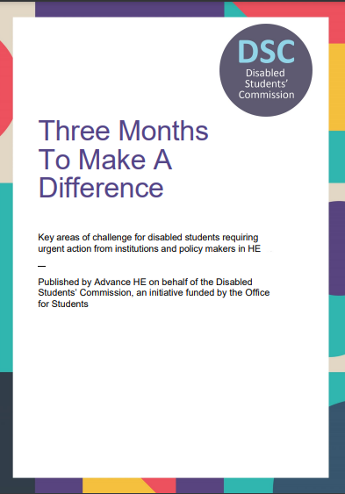
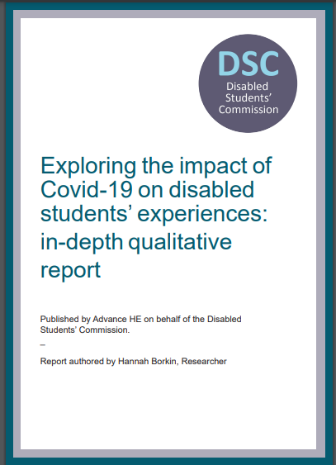

The Disabled Students’ Commission
The Disabled Students’ Commission (DSC) was an independent body, funded by OfS and established for a three year period from March 2020 by the Department for Education (DfE). Headed by Prof Geoff Layer, University Disability and Access Ambassador
With an agenda to challenge, advise, and inform the sector on ways to enhance the disabled student experience.

Slide 36
Disabled Students in Higher Education
2.2m students in total in 21/22
Increasing number share a disability diagnosis at point of application. See UCAS application data.
Overall an increasing share of students identify as being disabled
Attainment gaps are falling
The sector has formally aligned to the social model of disability

Slide 37
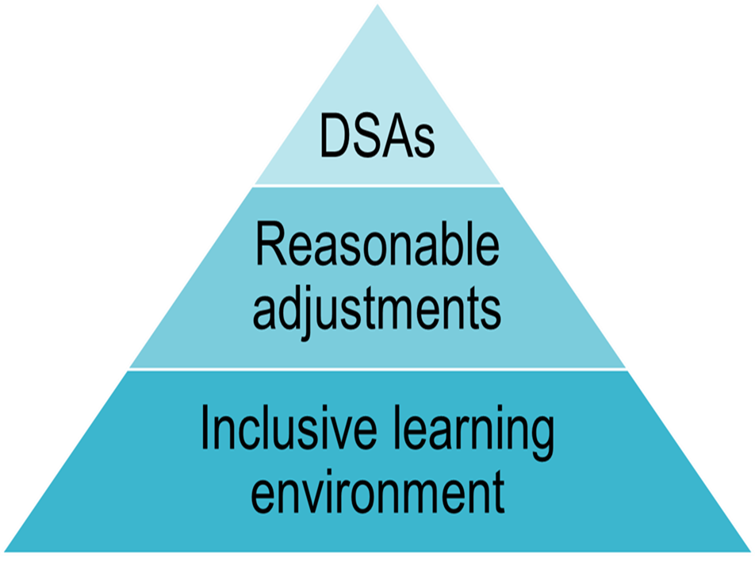
Sector Approach
Legal duties set out in the Equalities Act
Sector aligns to an anticipatory approach to meeting student needs
Sector commits to an inclusive learning environment: access content, participate fully and demonstrate knowledge and strengths.
A funding model that gives some core funding
A regulator that includes disability as part of widening participation and encourages an evidence-based approach

Slide 38
Sector challenges
56% of disabled students research available support before applying to university and are influenced by the support offer (UCAS, Next Steps, 2022). But do they find what they need?
DSA take-up is also increasing year-on-year across all levels of study, but lowest for students with a mental health condition (Advance HE, Equality in HE Statistical Report 2021) and review of DSA due.
Disabled students complain about unevenness of approach and uncertainty (Higher Education Commission, Arriving at Thriving Report, 2020)
Proportion of complaints related to disability discrimination (including complaints about reasonable adjustments) grew in 2021 compared to 2020 (OIAHE Annual Report, 2021)
Disabled graduates significantly less likely to be in full-time employment, but growth in the number of disabled graduates undertaking postgraduate qualifications. (AGCAS, What Happens Next 2022)

Slide 39
The Commitment & What Students Wanted

Slide 40
Four ‘c’s are required:
Certainty
Consistency
Communication
Choice

Slide 41

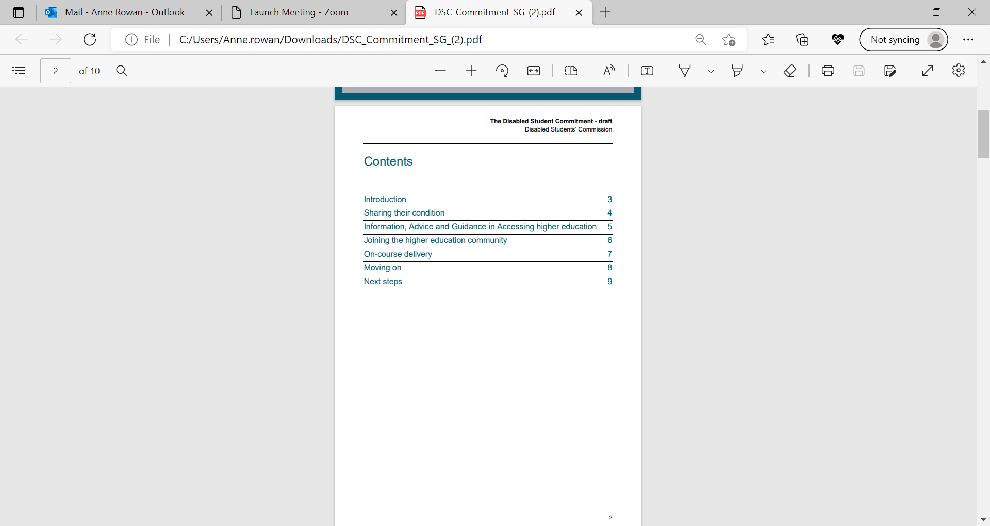
The Disabled Student Commitment
The Disabled Student Commitment – launched in April 2023, following consultation with disabled students, sector bodies, academics and professional services staff. Call to make the step change that is required to create a more inclusive environment.

Slide 42
The Disabled Student Commitment –
What is the ask?
HEPs to work with disabled students to have a holistic and strategic plan to enhance the student experience through the student lifecycle
PSRBs to produce guidance on support available for disabled students within the profession
Employers to address the need for a welcoming environment for disabled graduates
A joint review and an annual progress statement

Slide 43
The Disabled Student Commitment:
Key Principles
Requests to share information
Joining the higher education community
On-course delivery
Information advice and guidance in accessing higher education
Moving on from studying in higher education

Slide 44
Information, Advice and Guidance (IAG)
Universities to ensure
Information, Advice and Guidance (IAG) for disabled students available to all applicants
Provide comprehensive information on disabled student support
That outreach strategy includes a specific disability focus
Open days are fully accessible
Professional, Statutory and Regulatory Bodies (PSRBs) to produce accessible information on jobs and roles and support they provide to disabled professionals

Slide 45
Belonging
Provide inclusive welcoming activities
Support should be in place from day one
Support plan known and understood by those who need to know
Ensure inclusive curriculum design
Provide choice in form of assessment
Extenuating circumstance, appeals and complaints policies - Indicate how disabled students will be considered

Slide 46
Employability
Careers guidance should be provided by condition/barrier
Employer links specifically to address opportunities for disabled students
Employability to be addressed in curriculum
Promotion of Access to Work and Disability Passport
Work with Disability Access Ambassadors on sectoral basis
Employers to produce accessible information on roles and how disability supported

Slide 47
The (LSBU) Response

Slide 48
The value of the Disabled Student Commitment
Accountability against achievable goals and an action plan
Shared expectations through joint working with Disabled Students, and supporting new ways of working in partnership
The creation of new services or standards
Reflective approach that recognizes different starting points and looks at how progress can be made
An annual review allowing for more rigorous evidence collection

Slide 49
What does that mean for LSBU?
JOINT working with our students
Growing percentage of students share a disability, similar to the sector
40% supported by DSA, higher than the sector
Majority supported through inclusive teaching and reasonable adjustments
Moving towards a strong anticipatory approach
Looking particularly at professional/technical teaching and learning

Slide 50
Three key themes:
Consultation and partnership with disabled students
Building on our strengths and champions
Developing a student lifecycle approach
Thank you for listening!

Slide 52



To university and beyond: understanding and enhancing autistic students’ and graduates’ employment success
Dr Jonathan Vincent
Educational Research, Lancaster University
@jvincent_tweets
j.vincent3@lancaster.ac.uk
Notes:
Conference theme: Retaining compassion in constrained economic times - nurturing confidence and building resilient mental health support systems for staff and students.
It seeks to address the challenges staff may be experiencing when faced with the pressures from Covid, lack of funding and an increase in need: with a doubling of the numbers of children with Educational Health Care Plans since 2016, and an acceleration of these numbers since Covid, schools are struggling with a backlog, and a key factor for teachers leaving the profession is a lack of training in managing behaviour and students with complex needs. The Disability Students’ Allowance system is changing, with the potential for instability and insecurity for current roles and responsibilities, and there is a need to ensure that staff are equipped with the most up to date information, easing student transitions and access to critical support. At university, the number of learners applying to and entering HE with mental health conditions is increasing with associated risks of lower rates of continuation, attainment and progression, and the cost of living crisis is continuing to impact on all students' engagement with their studies, with 1 in 5 students considering dropping out. Knowing how to navigate the current climate and building confidence with students is paramount for professional development.
This conference is an opportunity to explore how schools, colleges and universities can support the mental health of staff and learners throughout the learner journey, what a healthy institution looks like and how sectors can facilitate preparation for HE through early disclosure to encourage students and staff to come forward for support.
The conference will be predominately for staff working in educational institutions (HE, FE, schools), but we recognise that staff in other sectors (health, social care etc) contribute to student well being and we will invite representatives from these sectors too.

Slide 53


outline
So, what can we do?
Employer knowledge & perspectives
Autistic graduates' experiences
Employment outcomes
Autism in Higher Education

Slide 54
What is autism?
Autism is a lifelong, developmental condition that affects how a person communicates with and relates to other people, and how they experience the world around them.
(National Autistic Society, UK)
Notes:
JV

Slide 55
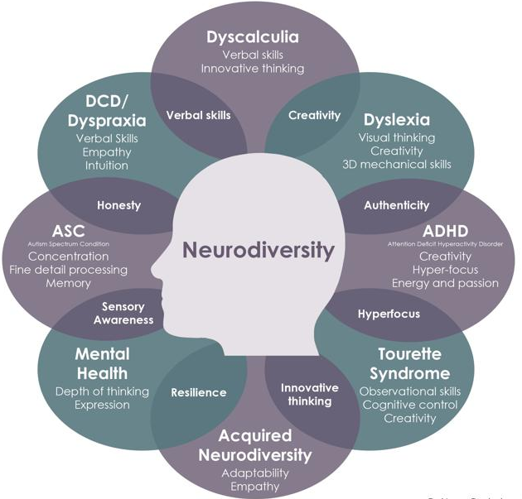
Neurodiversity has come to mean “variation in neurocognitive functioning” a broad concept that includes everyone: both neurodivergent people (those with a condition that renders their neurocognitive functioning significantly different from a “normal” range) and neurotypical people (those within that ‘socially acceptable’ range).
(Kapp, 2020:2)
(Doyle, 2020)​
Notes:
Range of conditions which overlap in strengths and challenges
Neuro-normativity = a "normal" way of processing information and engaging >> divergent from this and respectful of strengths as pat of it.
(Kapp, 2020:2)

Slide 56






Autism: strengths and challenges
Hypo- or hyper-sensitivity to sensory stimuli
Desire for routine / ‘restricted behaviours’
50% average / above average intelligence
Strengths eg working memory, systematic, attention to detail
Social and communication difficulties
Individual and spikey profiles

Slide 57

The autism spectrum
Very autistic
Not very autistic
‘Low functioning’
‘High functioning’
Notes:
HA

Slide 58

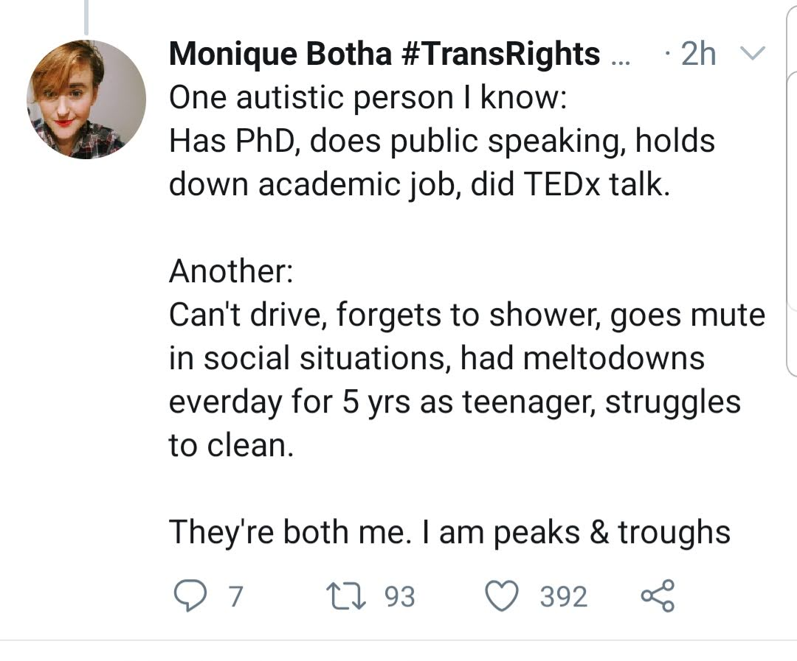
Communication differences
Reading others' emotions or intentions
Need for routine
Sensory filter
Executive function – starting / stopping tasks
Detail over ‘big picture’
Understanding social nuances
Working memory
Notes:
HA
Aim to have finished by 3.30

Slide 59
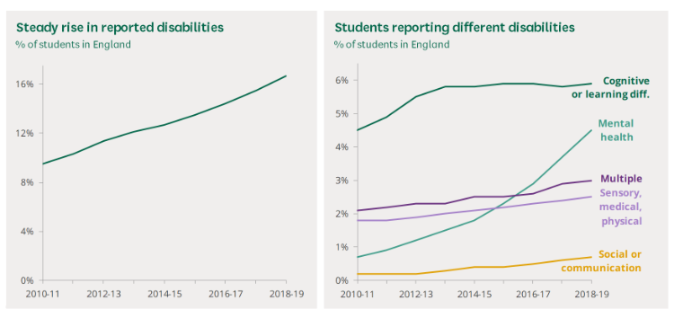
disabled students entering uk higher education
(Hubble and Bolton, 2021)
Notes:
Hubble, S. and Bolton, P. (2021) Support for disabled students in higher education in England. Briefing Paper, Number 8716, 22 February 2021 https://commonslibrary.parliament.uk/research-briefings/cbp-8716/
Access and Participation Plans (APPs) >>
The number of students in higher education with a known disability is increasing. In 2019/20 332,300 UK higher education students said that they had a disability of some kind, this was 17.3% of all home students. The number of students with a known disability has increased by 106,000 or 47% since 2014/15. Much of this increase has been in those reporting a mental health condition.

Slide 60
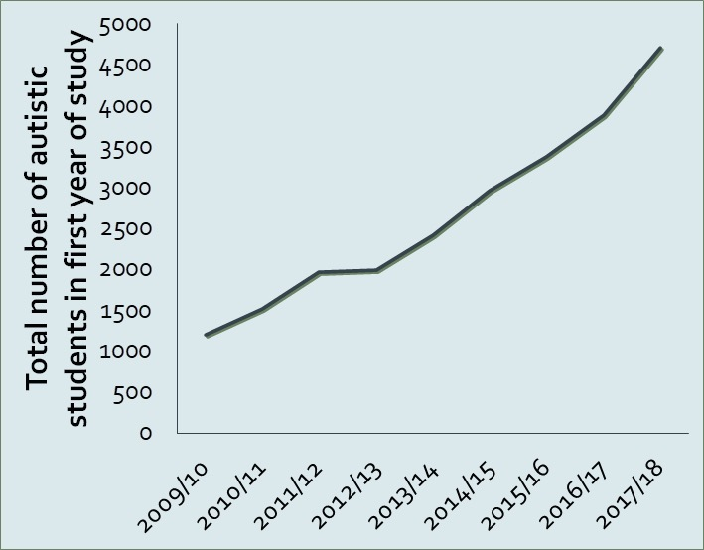
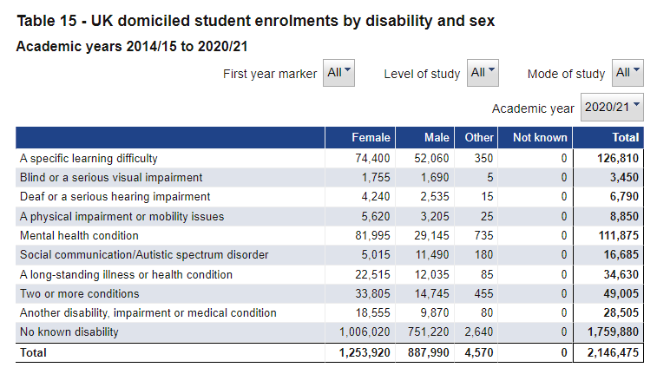
Autistic students in uk Higher Education
Notes:
Just disclosure rather than more autistic people 12815 in 2018/19 >> 16685 2020/21
Likely much higher – non disclosure, diagnostic process, girls/women, two or more

Slide 61
Employment outcomes
Over-representation in Creative subjects / computer science not STEM
Only 34% in FT work compared to 57% OD and 68% ND
15% unemployed - x2 more than OD (6%) and x5 ND (3%)
46% of female aut grads earn <£20k compared to 31% ND
(Vincent, J and Ralston, K. (2023) Uncovering employment outcomes for autistic university graduates in the UK: an analysis of population data, Autism)
Notes:
A number of academic programmes indicate higher proportions of autistic students compared with those reporting Other Disability and No Disability (see, Table 1.). This is particularly the case with respect to creative arts and design, where autistic women are more likely than the males to take these degrees (19% of autistic males and 23% of autistic females). Autistic representation in these subjects is almost three times higher as a proportion than students with No Disability (7% for males and 9% for females). Autistic students are similarly over-represented in computer science. Around 16% of autistic males and 4% autistic females had graduated with a degree in this academic programme compared to 7% of males and 1% of females with No Disability respectively.
By contrast, there are academic programmes with lower proportions of autistic students. Interestingly, these include STEM subjects such as Engineering and Technology (6% autistic males compared to 12% males with No Disability) and Allied Medicine degrees where the percentage of autistic female graduates was less than half (6%) as compared to women with Other Disability (13%) and women with No Disability (13%).

Slide 62
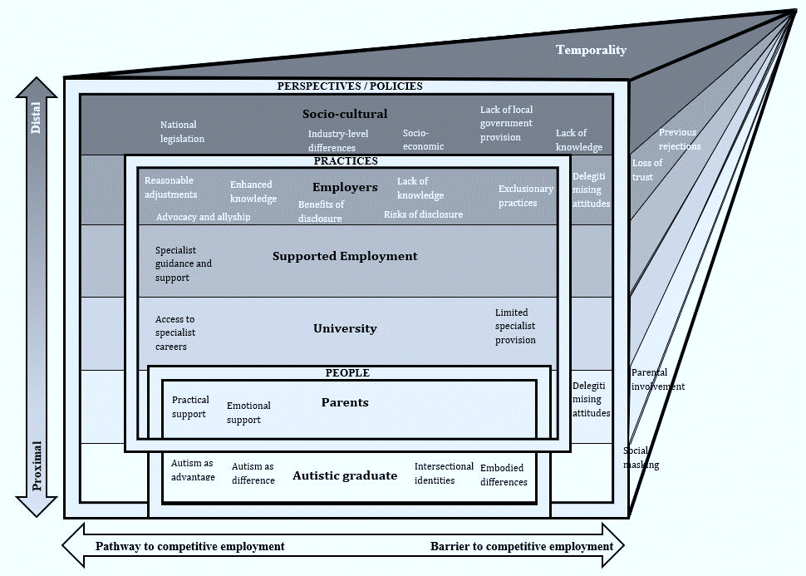
(Vincent and Fabri (2020) Barriers and pathways within the ecosystem of competitive employment for autistic university graduates, International Journal of Disability, Development and Education)

Slide 63
Understanding the employment gap
'I’ve applied for jobs and not disclosed that I’m disabled because if I say I’m disabled they’ll think I’m not worthy... they’ll think that I can’t do as much because I’m different. A lot of organisations don’t like employing disabled people and don’t like diversity – they’d rather go for someone who isn’t disabled who has the same qualifications, the same grades...'
(Grace, disabled graduate)
Vincent, J (2020) Employability for UK university students and graduates on the autism spectrum: Mobilities and materialities. Scandinavian Journal of Disability Research, 22(1), 12-24.
Notes:
HA

Slide 64
Neurodiversity paradigm
“You don’t want to turn autistic people into a product to sell… you know the conveyor belt ‘oh here’s the next set of people on the autism spectrum’
(Autistic Graduate, Focus Groups
“I think the neurodiversity model is useful because it appreciates the neurological differences but it doesn't pretend like there are no differences. It says you can clearly see the strengths and be an asset to companies but equally they have to acknowledge that there are things that are difficult too.”
(Public Sector, Focus Groups)
(Vincent and Fabri (2020) Barriers and pathways within the ecosystem of competitive employment for autistic university graduates, International Journal of Disability, Development and Education)

Slide 65




Employer knowledge and hiring attitudes
Good autism knowledge – esp with experience
Perceived barriers re flexibility, changes or social communication
Risk averse – financial and reputational
Potential for success in right conditions
Vincent, J, Harkry, L, & Hamilton, L. (under review) 'It actually makes us better people ourselves’: a mixed methods study of workplace knowledge of autism and attitudes toward hiring autistic people in the United Kingdom. Research in Autism Spectrum Disorders
Notes:
JV

Slide 66
Potential for success
“So, in terms of his knowledge it was just unbelievable, more so than myself and any of our other colleagues because he knew it. It wasn’t a broad outline he knew every single detail... So, in terms of the engagement with people, because a lot of our jobs are front-facing, he has an amazing confidence when speaking about his subject”
(Hiring manager, Museum)
Vincent, J, Harkry, L, & Hamilton, L. (under review) 'It actually makes us better people ourselves’: a mixed methods study of workplace knowledge of autism and attitudes toward hiring autistic people in the United Kingdom. Research in Autism Spectrum Disorders

Slide 67




What can academic staff / employers do?
Increase
understanding
Listen
attentively
Create psychological safety
Collaborate on solutions
Notes:
JV / HA
Listen to the neurodivergent person when they explain their challenges and take the time (or pay someone to take the time) to navigate these challenges. In my opinion, there is nothing we can't do, just things we haven't yet figured out how to do in a sustainable way....The biggest thing missing for me in my employment journey has been employers willing to take the time to help me achieve my full potential. I really really believe that ND workers have at least as much, and in some ways much much more to offer than NT workers, but we take longer to understand and settle in. I think investing time in individual ND employees, not on hiring strategies, is a very good investment for the loyalty, attention to detail and creative thinking which will come in return.

Slide 68
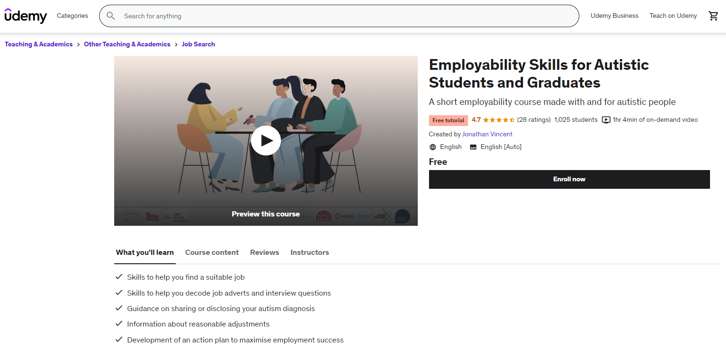
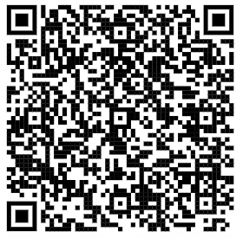
What can students / graduates do?
For free access, go to:
www.t.ly/ScbK
Notes:
https://www.udemy.com/course/employability-skills-for-autistic-students-and-graduates/

Slide 69
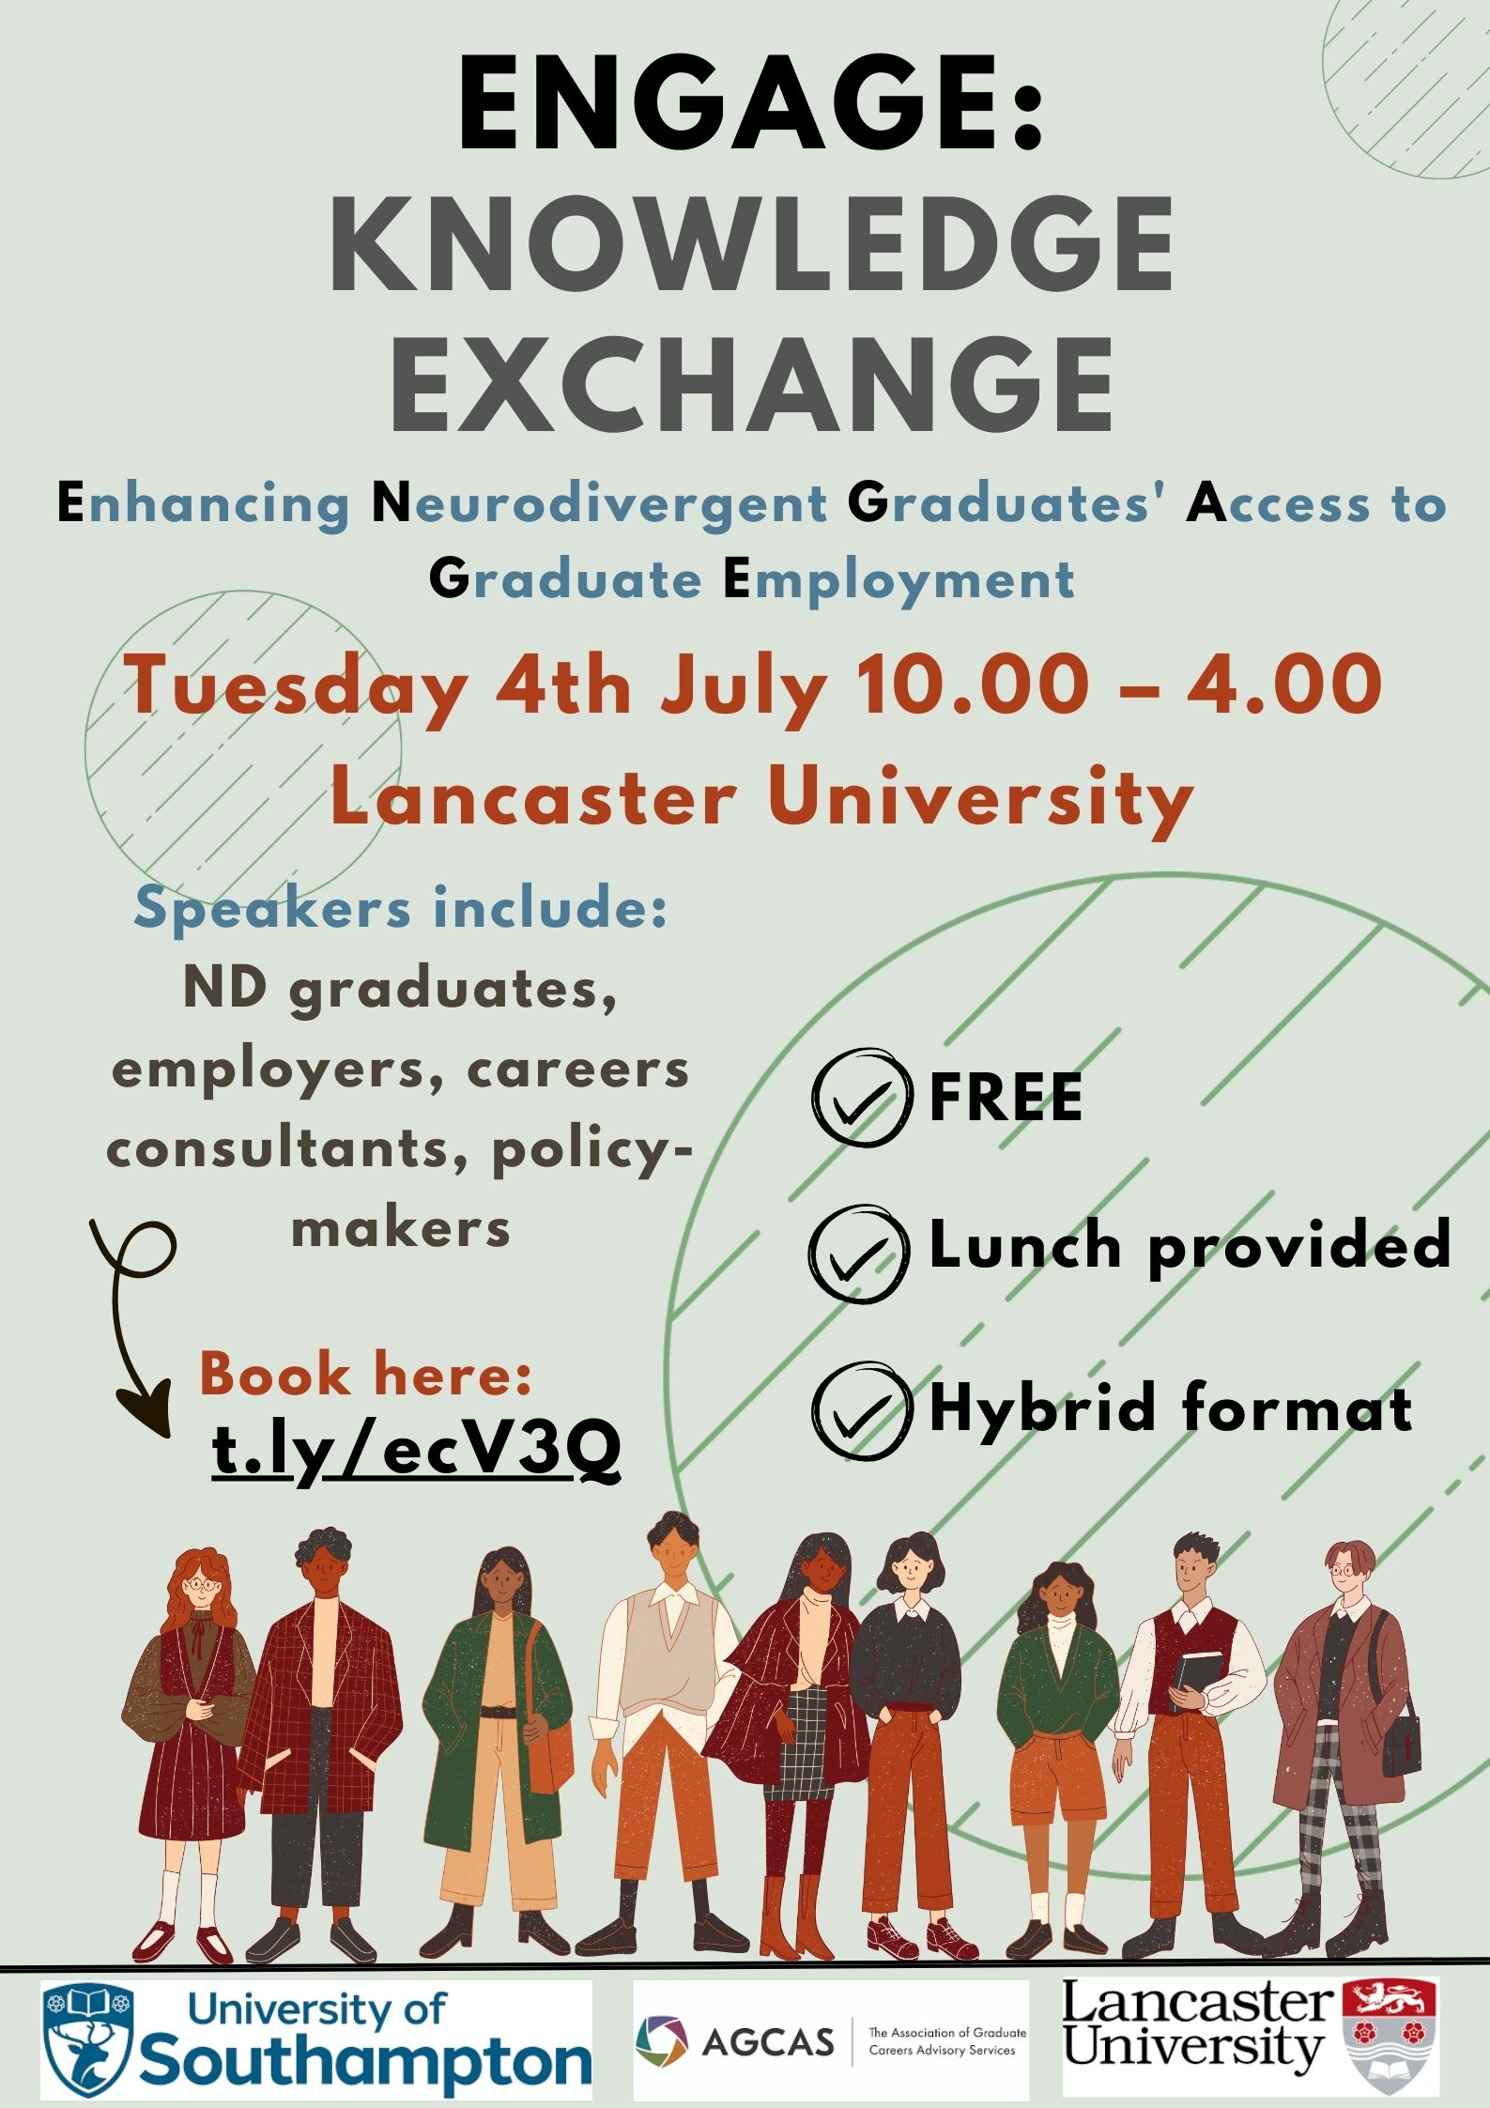
Knowledge exchange
Continue the conversation with us!
Tuesday 4th July 10.00-4.00 at Lancaster University
In-person or online!
Book: www.t.ly/ecV3Q

Slide 70





Thanks
ND/autistic students, graduates, employers, other professionals who gave up their time to participate in the studies
Churchill Fellowship, York St John University, Lancaster University who funded the research
Autistic coaches, mentors, and allies who developed some of the materials

Slide 71
References
Hubble, S and Bolton, P (2021) House of Commons Library: Briefing Paper Number 8716, 22 February 2021: Support for disabled students in higher education in England
Kapp, S. K. (2020). Autistic community and the neurodiversity movement: Stories from the frontline (p. 330). Springer Nature.
Vincent, J., & Ralston, K. (2023). Uncovering employment outcomes for autistic university graduates in the UK: An analysis of population data. Autism.
Vincent, J, Harkry, L, & Hamilton, L. (under review) 'It actually makes us better people ourselves’: a mixed methods study of workplace knowledge of autism and attitudes toward hiring autistic people in the United Kingdom. Research in Autism Spectrum Disorders.
Vincent, J., & Fabri, M. (2022). The ecosystem of competitive employment for university graduates with autism. International Journal of Disability, Development and Education, 69(5), 1823-1839.
Vincent, J. (2020). Employability for UK university students and graduates on the autism spectrum: Mobilities and materialities. Scandinavian Journal of Disability Research, 22(1), 12-24.
Employability Skills for Autistic Students and Graduates. Udemy. https://www.udemy.com/course/employability-skills-for-autistic-students-and-graduates/

Slide 72


Slide 73
One Experience of the School-University Transition
Labeebah Islaam

Slide 74
One Experience of the School-University Transition
Labeebah Islaam

Slide 75
Overview
Context
School to university
  Early education
  Sixth Form
At university
  Settling in
  Transition to work
Summary

Slide 76

My Opinions in Context
Grew up in inner city London to a multi-ethnic, multi-faith family
First 11 years of education in an independent Islamic school
Sixth form in a state comprehensive school
Diagnosed with Autism in the summer after A-Levels
Autism
Ethnicity
Religion
Socio-
economic status

Slide 77
KS1-GCSE education
My independent Islamic school didn’t admit students with special needs
I never ‘masked’ any of my behaviours:
  Innocuously made inappropriate comments
  Little interest in other students
  Forgetful and shy, not speaking for long stretches
  Often failed to do homework, but got good grades
  Tried to ‘reason’ with teachers when challenged
⇒ Frequent detentions, calls to parents, suspensions and threat of expulsion. Autism never considered.

Slide 78

Sixth Form
Meeting new people for the first time

Slide 79
Sixth Form
Going into a completely new environment made me feel very strange! Sometimes I would go without speaking for weeks.
Luck: My school had an excellent reputation with SEND provision and in education generally
Luck: People were always interested in what I was doing.

Slide 80
Sixth Form - Improving Conversations
Because I rarely spoke, teachers listened to me when I did.
They often spoke in half-sentences and expected me to fill in the rest. I liked doing that
Staff and students sensed when I was having trouble with a task.
  Other students would speak on my behalf
  Teachers would accept me not looking them in the eye
People spoke to me a lot without expecting a reply. Then I got to understand them better

Slide 81
Sixth Form
At school I did SaLT (speech and language therapy).
  As I didn’t have a diagnosis or expect any diagnoses, I was confused but went along with it.
  It helps a lot to learn conversational skills formally!
Going to SaLT and having peers and teachers willing to let me practise speaking to them was the single thing that improved my state the most.

Slide 82

Bonus slide - How I chose Physics
I switched from A-level Biology to A-level Physics after 2 months because the Biology teacher told me off for being too quiet.
The Physics teacher was a nice man. Cue conversation:
Did you go to university Sir?
Yes! I did Physics at Manchester. It was great.
I then filled in my UCAS application to do Physics at Manchester. Sir never found out my motivations…

Slide 83
University

Slide 84

University - Settling In
Freshly diagnosed with ASD and moving to Manchester.
Challenge: Little family experience of university, so I didn’t know what to expect
Challenge: New and unanticipated duties spawned new anxieties
Challenge: Unclear rules and unwritten social norms
Fig 2: Me, circa. 2019-2021

Slide 85
University - New expectations
I moved away from home to go to university:
  No familiar faces in new city
    My teacher had told me stories about some of the lecturers, and one of the lecturers was a university acquaintance of his.
    Some students were naturally friendly and would strike up conversation.
University could’ve had optional inductions and events for new students, instead of leaving it all to the overwhelmed newcomer!

Slide 86
University - New expectations
I moved away from home to go to university:
  I knew the theory but not the practise of doing domestic duties (washing, cooking, shopping) should’ve asked parents to teach me
    I asked childhood friends instead. They gladly provided instruction
  Too nervous to join societies.
    Forced myself to run for PhysSoc committee and got in just before Covid-19.

Slide 87
University - Being an adult
I was suddenly expected to follow new social norms as an adult
  Took years to get out of the habit of calling professors ‘sir’ or by their full title
Luck: People around me would often tell me where I was going wrong, without being upset.
Parents and tutors may anticipate receiving ‘silly questions’. If a student is comfortable enough to ask you, it means they like you! Be patient with them if you can.

Slide 88
University - Setbacks
I did one semester of university before the Covid-19 pandemic. 2nd year online only.
  1st semester average 60%. I put this down to being nervous.
  2nd year average 75%. Open book exams.
  3rd year average 55%. In-person exams. Very hard!
Did not have the right exam adjustments in place. This in addition to me feeling nervous and out of place lead to me retaking the year.

Slide 89
University - Transition to work
Success: My careers service is mindful about the needs of disabled students.
  Specific appointments with staff specialising in disability employment
  Encouraged to engage with relevant groups:
    Employability
    MyPlus Student’s club
Otherwise, much careers information is shared between peers. I’m lucky to have well-meaning, career driven peers. Many don’t have this. A job for the careers advisor?

Slide 90
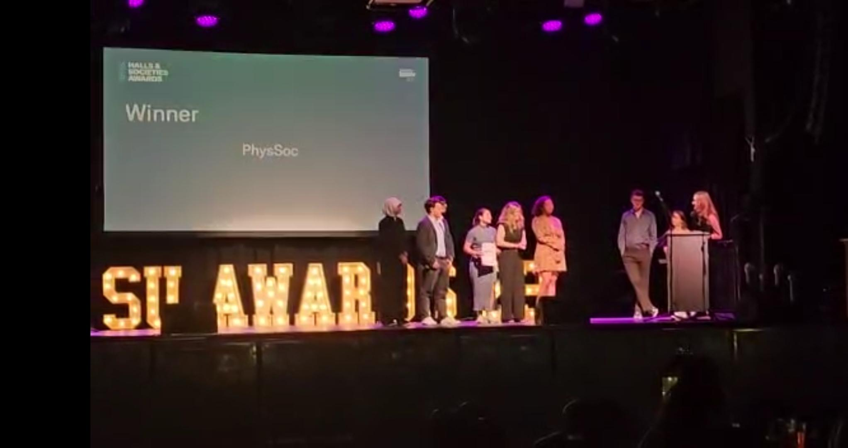
University - A Fresh Start
Since retaking the year, the university has helped me to stay in university:
  Fixing my exam adjustments
  Introducing me to a ‘social prescriber’ to find out about events
I got to know my peers better:

Slide 91
Summary + action points
Getting the best out of an Autistic student will often require special attention.
Schools:
  Extend your SEND provision to any student you suspect will benefit
  Include the parents/carers in getting their child ready for independent living
  Set realistic expectations. Ask the student what they expect to happen at university, and correct them kindly if they are mistaken.
  The student may not seem 100% ready by the end of school, but encourage them and don’t hold them back.
  Don’t let parents get too worried and hold their child back!

Slide 92
Summary + action points
Getting the best out of an Autistic student will often require special attention.
Universities:
  Email new students asking if they need to sign up with the disability service
  Good induction is critical. Have an additional optional induction for students who need more information
  If possible, assign Autistic students to a subject tutor who has some knowledge and empathy for dealing with said students.
  Fix the disability service and websites to make them up-to-date!

